Slide 1

Software Requirements
By: Ms.Monali Gandhi
Notes:
NOTE:
To change the image on this slide, select the picture and delete it. Then click the Pictures icon in the placeholder to insert your own image.

Slide 2
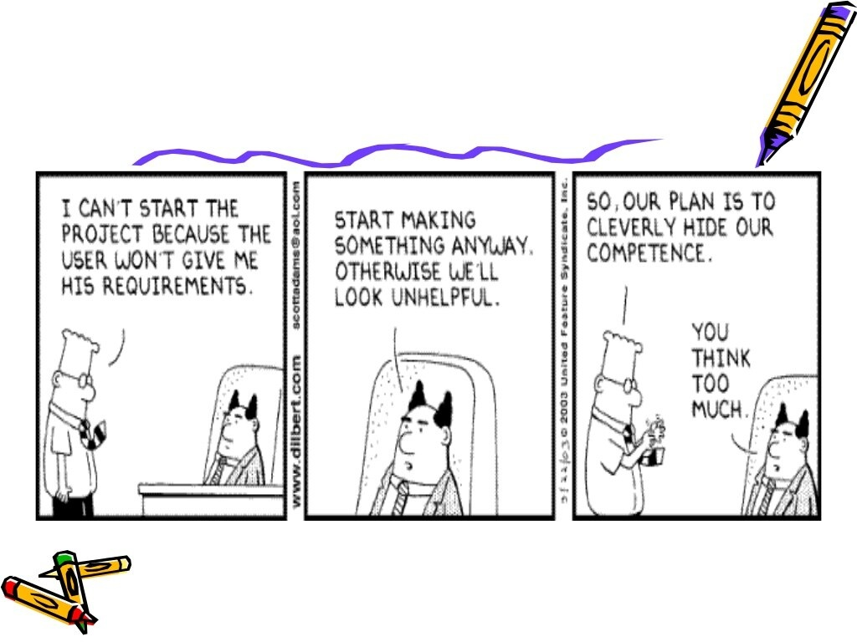

Slide 3
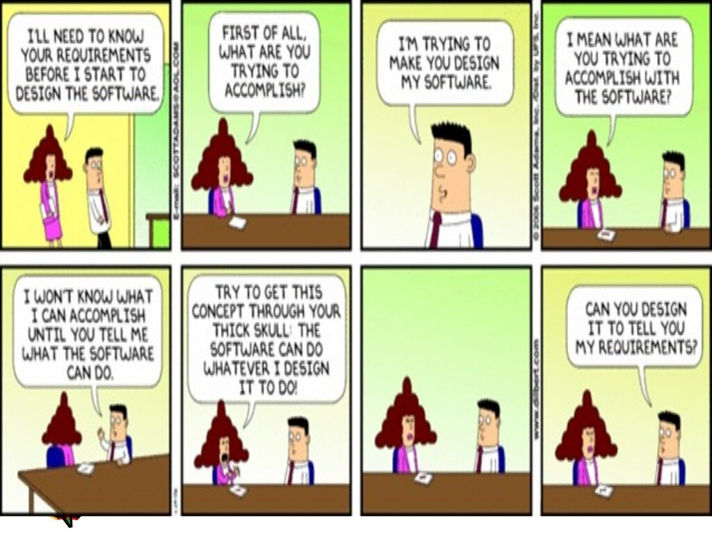

Slide 4
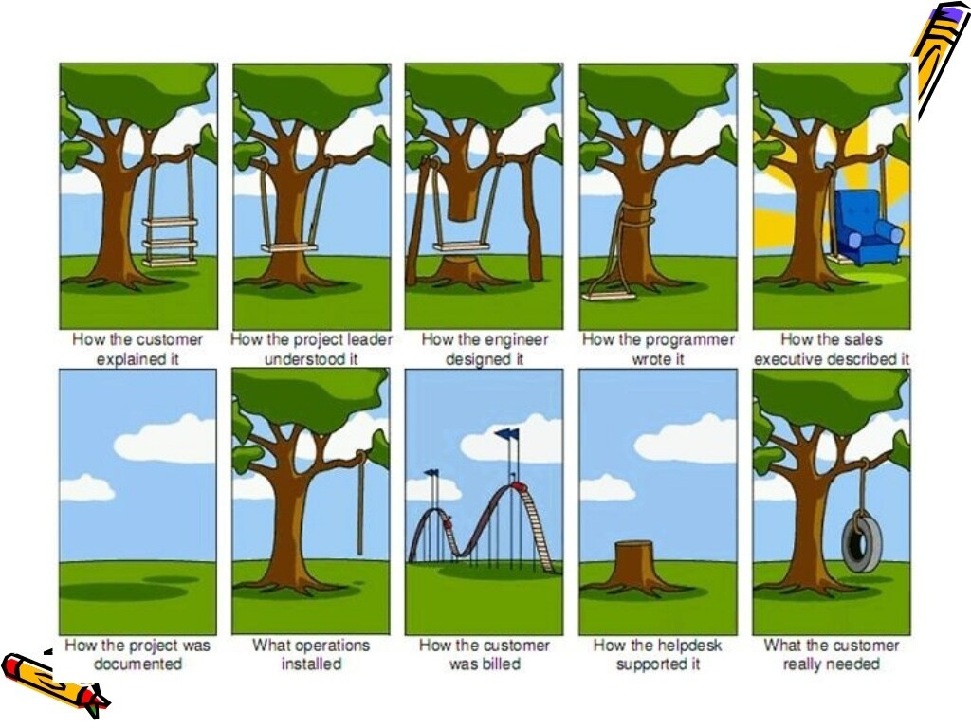

Slide 5
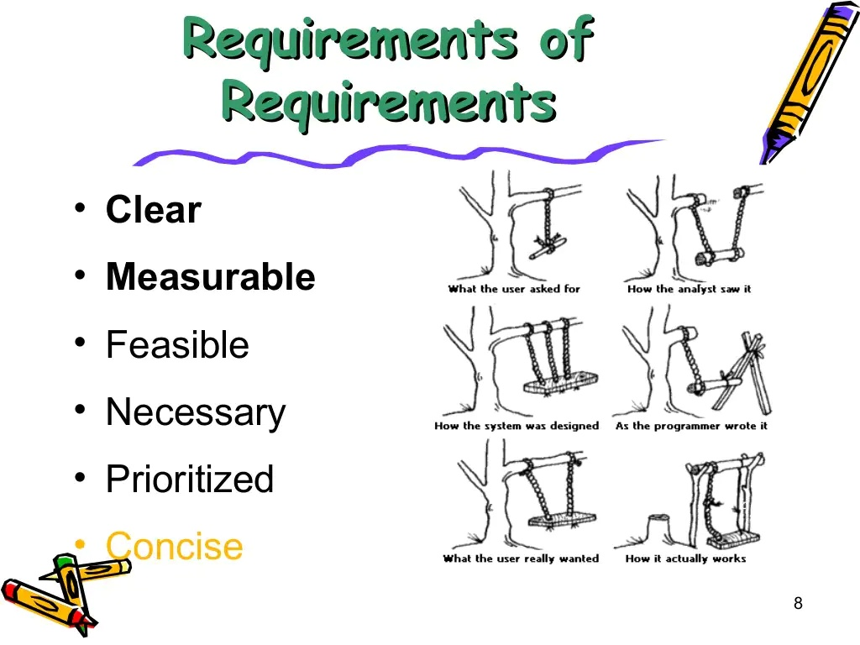

Slide 6
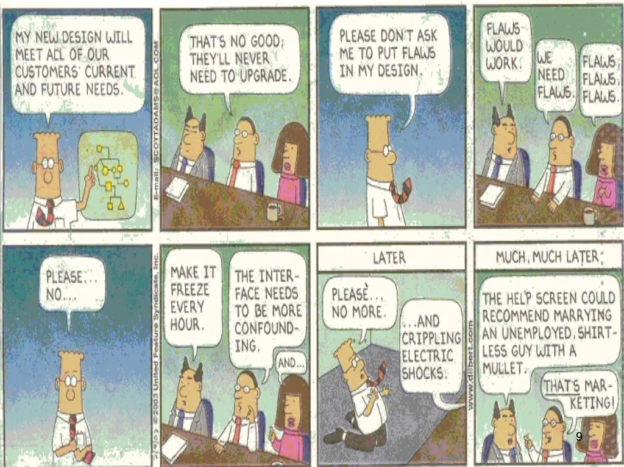

Slide 7
2.1 Introduction
In requirement engineering there is a systematic use of principles, technique and tools for cost effective analysis, documentation and user needs. Both the software engineer and customer like an active role in requirement engineering.
In this chapter we will discuss the concept of user and functional requirements. We describe functional and non functional requirements. Finally we will learn how software requirements may be organized in requirements document.
What is requirement engineering ?
The requirements themselves are the descriptions of the system services and constraints that are generated during the requirements engineering process.
Requirement engineering is process of
Establishing the services that customer requires from a system.
And constrains under which it operates and is developed.

Slide 8
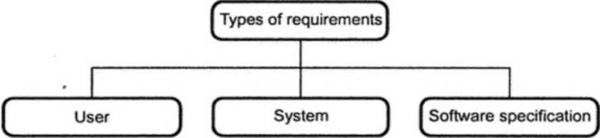
Conti…
What is a requirement?
A requirement can range from a high-level abstract statement of a service or of a system constraint to a detailed mathematical functional specification.
The requirement must be open to interpretation and it must be defined in detail.
Types of requirements
The requirements can be classified as

Slide 9
Conti…
User requirements
It is a collection of statements in natural language plus description of the services the system provides and its operational constraints. It is written for customers.
System requirements
It is a structured document that gives the detailed description of the system services. It is written as a contract between client and contractor.
Software specification
It is a detailed software description that can serve as a basis for design or implementation. Typically it is written for software developers.

Slide 10
2.2 Type of Requirement Engineering
Various types of requirements can be
Functional and non functional requirements.
User requirements.
Software system requirements can be classified as functional and non functional requirements. Let us discuss these requirement in more details.
2.2.1 Functional Requirements
Functional requirements should describe all the required functionality or system services.
The customer should provide statement of service. It should be clear how the system should react to particular inputs and how a particular system should behave in particular situation.
Functional requirements are heavily dependent upon the type of software, expected users and the type of system where the software is used.
Functional user requirements may be high-level statements of what the system should do but functional system requirements should describe the system services in detail.

Slide 11
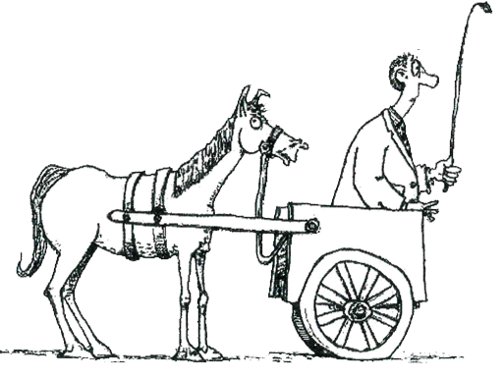
Functional & Non-Functional requirements
Functional requirements
Non-Functional requirements
Don't put what you want to do - before how you need to do it
Notes:
https://reqtest.com/requirements-blog/understanding-the-difference-between-functional-and-non-functional-requirements/

Slide 12
Conti…
For example : Consider a library system in which there is a single interface provided to multiple databases. These databases are collection of articles from different libraries. A user can search for, download and print these articles for a personal study.
From this example we can obtain functional requirements as -
The user shall be able to search either all of the initial set of databases or select a subset from it.
The system shall provide appropriate viewers for the user to read documents in the document store.
A unique identifier (ORDER_ID) should be allocated to every order. This identifier can be copied by the user to the account's permanent storage area.

Slide 13
Conti…
2.2.1.1 Problems Associated with Requirements
Requirements imprecision -
Problems arise when requirements are not precisely stated.
Ambiguous requirements may be interpreted in different ways by developers and users.
Consider meaning of term 'appropriate viewers'.
User intention – Special purpose viewer for each different document type.
Developer intention – provide a text viewer that shows the contents of document.
Requirements completeness and consistency -
The requirements should be both complete and consistent. Complete means they should include descriptions of all facilities required. Consistent means there should be no conflicts or contradictions in the descriptions of the system facilities.
Actually in practice, it is impossible to produce a complete and consistent requirements document.

Slide 14
2.2.2 Non Functional Requirements
The non functional requirements define system properties and constraints.
Various properties of a system can be : Reliability, response time, storage requirements. And constraints of the system can be : Input and output device capability, system representations etc.
Process requirements may also specify programming language or development method.
Non functional requirements are more critical than functional requirements. If the non functional requirements do not meet then the complete system is of no use.

Slide 15
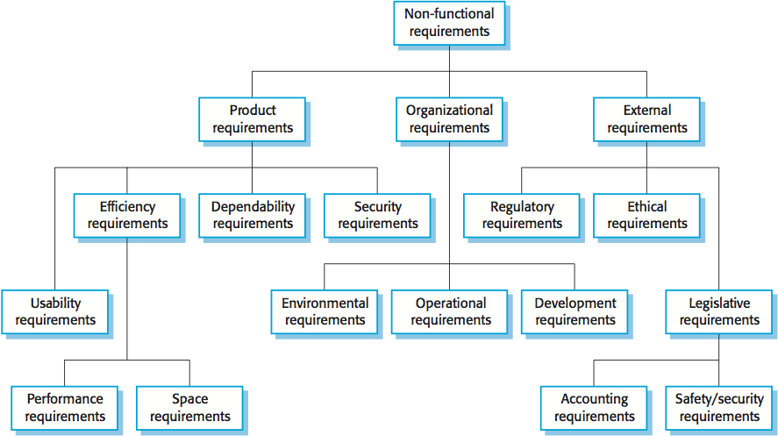
Types of Non Functional Requirements

Slide 16
2.2.2.1 Types of Non Functional Requirement
Product requirements
These requirements specify how a delivered product should behave in a particular way. For instance : Execution speed, reliability.
Organizational requirements
The requirements which are consequences of organizational policies and procedures come under this category. For instance : Process standards used implementation requirements.
External requirements
These requirements arise due to the factors that are external to the system and its development process. For instance : Interoperability requirements, legislative requirements.
In short, non functional requirements arise through
User needs.
Because of budget constraints.
Organizational policies.
The need for interoperability with other software or hardware systems.
Because of external factors such as safety regulations

Slide 17
2.3 Requirements engineering Tasks
Requirement engineering is the process characterized for achieving following goals
Understanding customer requirements and their needs.
Analyzing the feasibility of requirement
Negotiating the reasonable solutions.
Specification of an unambiguous solution.
Managing all the requirements of the project.
Finally transforming the requirements into the operational system.

Slide 18
Conti…
Inception
Requirement engineering process performs following seven distinct functions.
Elicitation
Elaboration
Negotiation
Specification
Validation
Requirements
Management

Slide 19
Conti…
2.3.1 Inception
The inception means specifying the beginning of the software project. Most of the software project get started due to business requirements. There may be potential demand from the market for a particular product and then the specific software needs to be developed.
There exist several stakeholders who define the business ideas. Stakeholders mean an entity. That takes active participation in project development. In software project development, the stakeholders that are responsible for defining the ideas are business mangers, marketing people, product managers and so on. Their role is to do rough feasibility study and to identify the scope of the project.
During the inception a set of context free questions is discussed. The purpose of inception is to
Establish the basic understanding of the project.
Find out all possible solutions and to identify the nature of the solution.
Establish an effective communication between developer and the customer.

Slide 20
Conti…
2.3.2 Elicitation
Before the requirements can be analyzed and modelled they must undergo through the process of elicitation process. Requirements elicitation means requirements discovery. Requirements elicitation is very difficult task.
Following are the reasons for : why it is difficult to understand customer wants —
Customer sometimes is unable to specify the scope of the project. Sometimes customers specify too many technical details and this may increase the confusion.
There is difficulty in understanding the problem. Sometimes customer could not decide what are their needs and wants. Sometimes they have got poor understanding of capabilities and limitations the existing computing environment. Sometimes customers find it difficult to communicate with the system engineer about their needs. Sometimes customers may have got some conflicting requirements. This ultimately results in specifying ambiguous requirements.
As project progresses the needs or requirements of the customers changes. This creates a problem of volatility.

Slide 21
Conti…
2.3.3 Elaboration
Elaboration is an activity in which the information about the requirements is expanded and refined. This information is gained during inception and elicitation.
The goal of elaboration activity is to prepare a technical model of software functions, features and constraints.
The elaboration consists of several modelling and refinement tasks. In this process several scenarios are created and refined. Basically these scenarios describe how end user will interact with the system.
During elaboration, each user scenario is parsed and various classes are identified. These classes are nothing but the business entities that are visible to end user. Then the attributes and services (functions) of these classes are defined. Then the relationship among these classes is identified. Thus various UML are developed during this task.
Finally the analysis model gets developed during the elaboration phase.

Slide 22
Conti…
2.3.4 Negotiation
Sometimes customer may demand for more than that is achieved or there are certain situations in which customer demands for something which cannot be achieved in limited business resources. To handle such situations requirement engineers must convince the customers or end users by solving various conflicts. For that purpose, requirement engineers must ask the customers and stakeholders to rank their requirements and then priority of these requirements is decided, using iterative approach some requirements are eliminated, combined or modified. This process continues until the users satisfaction is achieved.

Slide 23
Conti…
2.3.5 Specification
A specification can be a written document, mathematical or graphical model, collection of use case scenarios, or may be the prototypes.
There is a need to develop a standard specification in which requirements are presented in consistent and understandable manner.
For a large system it is always better to develop the specification using natural language and in a written document form. The use of graphical models is more useful for specifying the requirements.
Specification is the final work product of requirement engineering process. It describes the functions, constraints and performance of computer based systems.

Slide 24
Conti…
2.3.6 Validation
Requirement validation is an activity in which requirement specification is analyzed in order to ensure that the requirements are specified unambiguously. If any inconsistencies, omissions and error are identified then those are corrected or modified during the validation.

Slide 25
2.3.7 Requirement Management
Requirement management is the process of managing, changing requirements during the requirement engineering process and system development.
Why Requirements get change ?
Requirements are always incomplete and inconsistent. New requirements occur during the process as business needs change and a better understanding of the system is developed.
System customers may specify the requirements from business perspective that can conflict with end user requirements
During the development of the system, its business and the technical environment may get changed.

Slide 26
Conti…
Traceability is concerned with relationship between requirements their sources and the system design.
Various types of traceability are
Source traceability - These are basically the links from requirement to stakeholders who propose these requirements.
Requirements traceability - These are the links between dependent requirements.
Design traceability- These are the links from requirements to design. • Case tool support is required for
Requirement storage
Change management
Traceability management

Slide 27
Conti…
Traceability information is typically represented by a data structure Traceability matrix. If one requirement is dependent upon the other requirement then in that row-column cell 'D' is mentioned and if there is a weak relationship between the requirements then corresponding entry can be denoted by 'R'.
Requirement ID | A | B | C | D | E | F
A |  | D |  |  | R
B |  |  | D
C |  |  |  | R
D |  |  | D |  |  | R
E
F | R |  |  | D

Slide 28


Requirements Engineering Tasks
1
Inception
Roughly define scope
A basic understanding of a problem, people who want a solution, the nature of solution desired
2
Elicitation (Requirement Gathering)
Define requirements
The practice of collecting the requirements of a system from users, customers and other stakeholders

Slide 29


Requirements Engineering Tasks cont.
3
Elaboration
Further define requirements
Expand and refine requirements obtained from inception & elicitation
Creation of User scenarios, extract analysis class and business domain entities
4
Negotiation
Reconcile conflicts
Agree on a deliverable system that is realistic for developers and customers

Slide 30

Requirements Engineering Tasks cont.
5
Specification
Create analysis model
It may be written document, set of graphical models, formal mathematical model, collection of user scenarios, prototype or collection of these
SRS (Software Requirement Specification) is a document that is created when a detailed description of all aspects of software to build must be specified before starting of project

Slide 31


Requirements Engineering Tasks cont.
6
Validation
Ensure quality of requirements
Review the requirements specification for errors, ambiguities, omissions (absence) and conflicts
7
Requirements Management
It is a set of activities to identify, control & trace requirements & changes to requirements (Umbrella Activities) at any time as the project proceeds.

Slide 32
2.4 Initiating the Requirements Engineering Process
The process of initiating engineering is the subject of this section. The point of view described is having all stakeholders (including customers and developers) involved in the creation of the system requirements documents.
The following are steps required to initiate requirements engineering:
Identifying the Stakeholders
Recognizing Multiple Viewpoints
Working toward Collaboration
Asking the First Questions

Slide 33
2.4.1 Identifying the Stakeholders
A stakeholder is anyone who benefits in a direct or indirect way from the system which is being developed.
In the book stakeholders are: operations managers, product managers, marketing people, internal and external customers, end-users, consultants, product engineers, software engineers, support and maintenance engineers, etc.
At inception, the requirements engineer should create a list of people who will contribute input as requirements are elicited.
The initial list will grow as stakeholders are contacted because every stakeholder will be asked ”Who else do you think I should talk to?”

Slide 34
2.4.2 Recognizing Multiple Viewpoints
Each of the stockholders will contribute to the RE process.
As information from multiple viewpoints is collected, emerging requirements may be inconsistent or may conflict with one another.
The requirements engineer is to categorize all stakeholder information including inconsistencies and conflicting requirements in a way that will allow decision makers to choose an internally inconsistent set of requirements for the system

Slide 35
2.4.3 Working toward Collaboration
Collaboration does not necessarily mean that requirements are defined by committee. In many cases, stakeholders collaborate by providing their view of requirements, but a strong “project champion” (business manager, or a senior technologist) may make the final decision about which requirements make the final cut.

Slide 36
2.4.4 Asking the First Questions
The first set of context-free questions focuses on the customer and other stakeholders, overall goals, and benefits.
The first questions:
Who is behind the request for this work?
Who will use the solution?
What will be the economic benefit of a successful solution?
Is there another source for the solution that you need?

Slide 37
Conti…
The next set of questions enables the software engineering team to gain a better understanding of the problem and allows the customer to voice his/her voice:
How would you characterize “good” output that would be generated by a successful solution?
What problems will this solution address?
Can you show me the business environment in which the solution will be used?
Will special performance issues or constraints affect the way the solution is approached?

Slide 38
Conti…
The final set of questions focuses on the effectiveness of the communication activity itself. Gause and Weinberg call these questions “meta questions”
Are you the right person to answer these questions? Are your answers “official”?
Are my questions relevant to the problem that you have?
Am I asking too many questions?
Can anyone else provide additional information?
Should I be asking you anything else?
“He who asks a question is a fool for 5 minutes, he who doesn’t ask a question is a fool forever.” Chinese proverb

Slide 39
2.5 Elicitation Requirement
Questioning is useful only at inception of the project but for detailed requirement elicitation it is not sufficient. During requirement elicitation certain activities such as problem solving, elaboration, negotiation and specification must be carried out. Various ways by which the requirement elicitation can be done are –
Collaborative requirement gathering
Quality function deployment
Use scenarios
Elicitation work product
Developing Use-Cases
Building the Analysis Model

Slide 40
2.5.1 Collaborative Requirement Gathering
Collaborative requirement fathering is don’t using collaborative, team-oriented approach.
Facility application specification technique (FAST) is an approach in which joint team of customers and developers work together to identify the problem, propose elements of solution, negotiate different approaches and prepare a specification for preliminary set of solution requirements.
Guideline for FAST approach:
A meeting should be conducted and attended by both software engineers and customers. "The place of meeting should be neutral site.
Rules for preparation and participation must be prepared.
An agenda should be prepared in such a way that it covers all the important point as well as it allows all the new innovative ideas.
A facilitator controls the meeting. He could be customer, developer or outsider.
A definition mechanism is used. The mechanism can be work sheets, flip charts, wall stickers, electronic bulletin board, chart room, virtual forum.

Slide 41
Conti…
6. The goal is to identify the problem, decide the elements of solution, negotiate different approaches and specify the preliminary set of solution requirements.
• In FAST meeting each FAST attendee is asked to prepare - a list of objects, list of services and a list of constraints.
The list of objects consists of all the objects used in the system, the objects that are produced by the system and the objects that surround the system.
The list of services contain all the required functionalities that manipulate or interact with the objects.
The list of constraints consists of all the constraints of the system such as cost, rules, memory requirement, speed accuracy etc.

Slide 42
Conti…
As the FAST meeting begins, the very first issue of discussion is the need and justification for the new product. Once everyone agrees upon the fact that the product is justified, each participant has to present his lists.
These lists are then discussed, manipulated and these modified or refined lists are combined by a group.
The combined list eliminates redundant entries adds new ideas that come up during the discussion. The combined list is refined in such a way that it helps in building the system.
The combined list should be prepared in such a way that a "consensus lists" can be prepared, for object, services and constraints.
A team is divided into sub-teams. Each sub-team develops a mini-specification from each consensus list.
Finally a complete draft specification is developed.

Slide 43

Collaborative Elicitation

Slide 44
Conti…
For example -
A FAST team is working on a commercial product. A following product description is given as below -
"Nowadays the market for video game is growing rapidly. We would like to enter this market with more features, like attractive GUI, multiple sound setting, realistic (3D) animations. This product is tentatively called 'Gamefun'. At the end of game, scores of each player should be displayed".
The FAST attendee prepare following lists -
List of objects - Display, menu, a sound, an event (moving from one level to another) and so on.
List of services - Setting sounds, setting colors in GUI, HELP, instructions for players, score card etc.
List of constraints - Must be user friendly, must have high speed, must accommodate less size, should have less cost.

Slide 45
Conti…
The mini specification for Menu (object) can be as given below -
Contains 'Start game' and 'exit' options.
List of all functional keys with corresponding functionality.
Software provides interaction guidance, quick tour, sound controls.
All players will play or interact through keys.
Software provides facility for change in the look of GUI.
Software displays scores of each player.

Slide 46
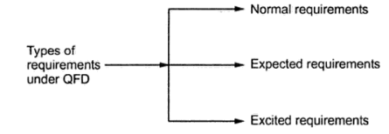
2.5.2 Quality Function Deployment (QFD)
Quality function deployment is a quality management technique which translates the customer needs and wants into technical requirements. This technique was introduced in Japan.
Under quality function deployment three types of requirements can be defined -
Normal requirements -
The requirements as per goals and objectives of the system are called normal requirements. These requirements can be easily identified during the meeting with the customer.

Slide 47
Conti…
For example : Handling mouse and keyboard events for any GUI based system.
Expected requirement
These types of requirements are such requirements which system must be having even if customer did not mention about them. These are such requirements that if they are not present then the system will be meaningless.
For example : A software package for presentation (like Microsoft Power Point) must have option of 'new slide insert', so that user will be able to insert a new slide at any position during his presentation.
Exciting requirements
When certain requirements are satisfied by the software beyond customer's expectations then such requirements are called exciting requirements.

Slide 48
Conti…
For example : Spell check facility in Microsoft Word is an exciting requirement. Various types of deployments that can be conducted during software development process are -
Function deployment : For determining the value of each function this deployment can be done.
Information deployment : After identifying various functionalities events and data objects must be identified.
Task deployment : The task associated with each function must be identified.
Value analysis : Identify the priorities of requirements. The technique of QFD requires proper interaction with customer.

Slide 49
2.5.3 Use scenarios
During requirement gathering overall vision for systems functions and features get developed.
In order to understand how these functions and features are used by different classes of end users, developers and users create a set of scenarios. This set identifies the thread of usage for the system to be constructed. This set is normally called as use-cases.
The use cases provide a description of how the system will be used.

Slide 50
2.5.4 Elicitation Work product.
Following are some work products that get produced during requirement elicitations
A statement of feasibility study performed in order to find the need of the project.
Statement for the scope of the system or product.
A list of various stakeholders such as customer, end users, technical persons, and many others who participate during requirement elicitations
A description in which system’s technical environment is described.
A list of requirements.
A list of constraints.
A set of usage scenarios that produce insight into the use of the system or product under different operating conditions.
The prototype that may get developed for defining the requirements in better manner.
There Work products are then reviewed by all the people who participate in requirement elicitations.

Slide 51
2.5.5 Developing Use-Cases
Use-cases are defined from an actor’s point of view. An actor is a role that users or devices play as they interact with the software engineer.
The first case in writing a use-case is to define the set of “actors” that will be involved in the story.
Actors are the different people or devices that use the system or product within the context of the functions and behavior that is to be described.
An actor is anything that communicates with the system or product and that is external to the system itself.
Because requirements elicitation is an evolutionary activity, not all actors are identified during the 1st iteration.
Primary actors interact to achieve required system functions and derive the intended benefit from the system

Slide 52
Conti…
Secondary actors support the system so that primary action can do their work. Once actors have been identified, use-cases can be developed. A number of questions that should be answered by a use-case:
Who is the primary actor, the secondary actor (s)?
What are the actor’s goals?
What preconditions should exist before the story begins?
What main tasks or functions are performed by the actor?
What extensions might be considered as the story is described?
What variations in the actor’s interaction are possible?
What system information will the actor acquire, produce, or change?
Will the actor have to inform the system about changes in the external environment?
What information does the actor desire from the system?
Does the actor wish to be informed about unexpected changes?

Slide 53
2.5.7 Building the Analysis Model
This section discusses analysis modeling. The elements of the analysis model (scenario-based, class-based, behavioral, and flow-oriented) are introduced.
The intent of the analysis model is to provide a description of the required informational, functional, and behavioral domains for a computer-based system.
The model changes dramatically as software engineers learn more about the system, and the stakeholders understand more about what they really require.

Slide 54
2.5.7.1 Elements of the Analysis Model
The specific elements of the analysis model are dictated by the analysis modeling method that is to be used. However, a set of generic elements is common to most analysis models.
Scenario-based elements: The system is described from the user’s point of view using a scenario-based approach.
It always a good idea to get stakeholders involved. One of the best ways to do this is to have each stakeholder write use-cases that describe how the software engineering models will be used.
Functional—processing narratives for software functions
Use-case- descriptions of the interaction between an “actor” and the system.
Class-based elements: Each usage scenario implies a set of “objects” that are manipulated as an actor interacts with the system.
These objects are categorized into classes- a collection of things that have similar attributes and common behaviors.

Slide 55
Conti…
One way to isolate classes is to look for descriptive nouns in a use-case script. At least some of the nouns will be candidate classes.
Behavioral elements: The state diagram is one method for representing the behavior of a system by depicting its states and the events that cause the system to change state.
A state is any observable mode of behavior. Moreover, the state diagram indicates what actions are taken as a consequence of a particular event.
Flow-oriented elements: Information is transformed as it flows through a computer-based system.
The system accepts input in a variety of forms; applies functions to transform it; and produces output in a variety of forms

Slide 56
2.6 Negotiating Requirements
The customer and the developer enter into a process of negotiation, where the customer may be asked to balance functionality, performance, and other product or system characteristics against cost and time to market.
The intent of the negotiations is to develop a project plan that meets the needs of the customer while at the same time reflecting the real-world constraints (time, people, and budget) that have been imposed on the software engineering team.
Boehm defines a set of negotiation activities at the beginning of each software process iteration. The following activities are defined:
Identify the key stakeholders. These are the people who will be involved in the negotiation.
Determine each of the stakeholders “win conditions”. Win conditions are not always obvious.
Negotiate; work toward a set of requirements that lead to “win-win”

Slide 57
2.7 Validating Requirements
The purpose of requirements validation is to make sure that the customer and developer agree on details of the software requirements (or prototype) before beginning the major design work. This implies that both the customer and developer need to be present during the validation process.
As each element of the analysis model is created, it is examined for consistency, omissions, and ambiguity.
The requirements represented by the model are prioritized by the customer and grouped within requirements packages that will be implemented as software increments and delivered to the customer.

Slide 58
Conti…
A review of the analysis model addresses the following questions:
Is each requirement consistent with the overall objective for the system/product?
Have all requirements been specified at the proper level of abstraction? That is, do some requirements provide a level of technical detail that is inappropriate at this stage?
Is the requirement really necessary or does it represent an add-on feature that may not be essential to the objective of the system?
Is each requirement bounded and unambiguous?
Does each requirement have attribution? That is, is a source (generally, a specific individual) noted for each requirement?
Do any requirements conflict with other requirements?

Slide 59
Conti…
Is each requirement achievable in the technical environment that will house the system or product?
Is each requirement testable, once implemented?
Does the requirements model properly reflect the information, function and behavior of the system to be built?
Has the requirements model been “partitioned” in a way that exposes progressively more detailed information about the system.
Have requirements patterns been used to simplify the requirements model. Have all patterns been properly validated? Are all patterns consistent with customer requirements?
These and other questions should be asked and answered to ensure that the requirements model is an accurate reflection of the customer’s needs and that it provides foundation for design.

Slide 60
2.8 Requirements Specification
The software requirements document is the specification of the system. It should include both a definition and a specification of requirements. It is not a design document. As far as possible, it should set of what the system should do rather than how it should do it.
Software Requirements Specification
The software requirements provide a basis for creating the Software Requirements Specifications (SRS).
The SRS is useful in estimating cost, planning team activities, performing tasks, and tracking the team's progress throughout the development activity.
Typically software designers use IEEE STD 830-1998 as the basis for the entire Software Specifications. The standard template for writing SRS is as given below.

Slide 61
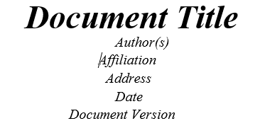
Conti…

Slide 62
Conti…
1. Introduction
1.1 Purpose of this document
Describes the purpose of the document.
1.2 Scope of this document
Describes the scope of this requirements definition effort. This section also details any constraints that were placed upon the requirements elicitation process, such as schedules, costs.
1.3 Overview
Provides a brief overview of the product defined as a result of the requirements elicitation process.

Slide 63
Conti…
2 General Description
Describes the general functionality of the product such as similar system information, user characteristics, user objective, general constraints placed on design team.
Describes the features of the user community, including their expected expertise with software systems and the application domain.
3 Functional Requirements
This section lists the functional requirements in ranked order. A functional requirement describes the possible effects of a software system, in other words, what the system must accomplish. Each functional requirement should be specified in following manner

Slide 64
Conti…
• Short, imperative sentence stating highest ranked functional requirement.
Description
A full description of the requirement.
Criticality
Describes how essential this requirement is to the overall system.
Technical issues
Describes any design or implementation issues involved in satisfying this requirement.
Cost and schedule
Describes the relative or absolute costs of the system.
Risks
Describes the circumstances under which this requirement might not able to be satisfied.
Dependencies with other requirements
Describes interactions with other requirements.
Any other appropriate

Slide 65
Conti…
4 Interface Requirements
This section describes how the software interfaces with other software products or users for input or output. Examples of such interfaces include library routines, token streams, shared memory, data streams, and so forth.
4.1 User Interfaces
Describes how this product interfaces with the user.
4.1.1 GUI
Describes the graphical user interface if present. This section should include a set of screen dumps to illustrate user interface features.
4.2 CLI
Describes the command-line interface if present. For each command, a description of all arguments and example values and invocations should be provided.
4.3 API
Describes the application programming interface, if present.

Slide 66
Conti…
4.2 Hardware Interfaces
Describes interfaces to hardware devices.
4.3 Communications Interfaces
Describes network interfaces.
4.3 Software Interfaces
Describes any remaining software interfaces not included above.
5 Performance Requirements
Specifies speed and memory requirements.
6 Design Constraints
Specifies any constraints for the design team such as software or hardware limitations.

Slide 67
Conti…
7 Other Non functional Attributes
Specification any other particular non functional attributes required by the system. Suc as
7.1 Security
7.2 Binary Compatibility
7.3 Reliability
7.4 Maintainability
7.5 Portability
7.6 Extensibility
7.7 Reusability
7.8 Application Compatibility
7.9 Resource Utilization
7.10 Serviceability
Others as appripriate

Slide 68
Conti…
8 Operational Scenarios
This section should describe a set of scenarios the illustrate , from the users perspective, what will be experiences when utilizing the system under various situations.
9 Preliminary schedule
this section provides an initial version of the project plan, including the major task to be accomplished, their interdependencies and their tentative start/stop dates.
10 Preliminary Budget
This section provides an initial budget for the project.
11. Appendices
11.1 Definitions, Acronyms, Abbreviations
provides definitions terms, and acronyms, can be provided.
11.2 References
Provides complete citations to all documents an meetings referenced

Slide 69
2.7.1 Characteristics of Good SRS
Various characteristics of SRS are
Correct
The SRS must be correct. That means all the requirements must be correctly mentioned, or the requirement must be realistic by nature. For instance: while developing a word processing software, if there is a requirement for spell check facility and If software can not find the spelling errors from the document, then that means requirement is incorrect.
Complete
To make the SRS complete, it should be specified what a software designer want tot create a software. The SRS s said to be complete only in following situations
When SRS consists of all the requirements related to functionality, performance, attributes, design constraints or external interfaces.
When labels and corresponding references are mentioned for all the figures, diagrams and tables in the SRS.
When expected responses to the input data is mentioned by considering validity and invalidity of an input.
Unambiguous
When requirements are understood correctly then only unambiguous SRS cab be written. Unambiguous specification means only one interpretation can be made from the specified requirements. In other words, there should be an unique interpretation of each statement in SRS. If for particular term there are multiple meanings then, those terms should be mentioned in glossary with proper meaning. The requirements should not be mentioned in the same manner.
After preparing SRS, it should be reviewed by third party. Normally SRS is written in some natural language like SRS. The SRS can be examined with the help of language processors, so the lexical, syntactic and semantic errors can be exposed.

Slide 70
Conti…
Consistent
If there are not conflicts in the specified requirements then SRS is said to be consistent. Three types of conflicts that may occur in a SRS.
Logical or temporal conflict : when on requirement specifies that event X should occur before event Y and if another requirement specifies that event Y should occur before event X.
Characteristics conflicts of real word object: if one requirement suggests to make use of “ radio button “ and other specifies the “check box button” then it represents conflicting characteristics.
Two different descriptions about the same real world object: if one requirement is specifying “Enter” and other specifies “submit” then it describes one and the same action.
Stability
In SRS, it is not possible to specify all the requirements. The SRS must contain all the essential requirements. Each requirement must be clear and explicit.
Verifiable
The SRS should be written in such a manner that the requirements that are specified within it must be satisfied by the software.
For instance “The GUI should look good” this requirement is not verifiable because one cannot specifically define “what is mean by good?”.
Traceable
If origin of requirement is properly given or references of the requirements are correctly mentioned then such a requirement is called as traceable requirement. Various types of traceability are
Forward Traceability : Each requirement is referred in the SRS document by its unique name or reference number.
Backward Traceability : If the reference to the requirement is mentioned in earlier document, then it is backward traceability.

Slide 71
2.7.2 Example of SRS
Software Requirements Specification
For
Attendance Maintenance System
Prepared by Atijali
December 1, 2007 Release 1.0
Version 1.0

Slide 72
Table of Contents
1. Introduction 1
Purpose 1
Scope 1
Overview 1
2. General Description 1
User Manual 1
3. Functional Requirements 1
Description 2
Technical Issues. .
4. Interface Requirements
GUI
Hardware Interface 3
Software Interface 3
5. Performance Requirements 4
6. Design Constraints 4
7. Other Non functional Attributes 4
Security 5
Reliability 5
Availability 5
Maintenability 5
Reusability 5
8. Operational Scenarios 5
9. Preliminary Schedule

Slide 73
Conti…
1. Introduction
1.1 Purpose
This document gives detailed functional and non functional requirements for attendance maintenance system. The purpose of this document is that the requirements mentioned in it should be utilized by software developer to implement the system.
1.2 Scope
This system allows the Teacher to maintain attendance record of the classes to which it is teaching. With the help of this system Teacher should be in a position to send e-mail to the students who remain absent for the class. The system provides a cumulative report at every month end for the corresponding class.
1.3 Overview
This system provides an easy solution to the Teacher to keep track of student attendance, and statistics.

Slide 74
Conti..
2. General Description
This attendance maintenance system replaces the traditional, manual attendance system by which a lot of paper work will be reduced. The Teacher should able to view photograph of a student along with his attendance in his Laptop. This is the primary feature of this system. Another feature is that Teacher can be allowed to edit particular record at desired time. The system should produce monthly attendance report. And there should be facility to send an e-mail/waming to the student remaining absent in the class.
Every Teacher should have Laptop with wireless internet connection. A Teacher may teach to different classes and a separate record for the corresponding classes should be maintained.

Slide 75
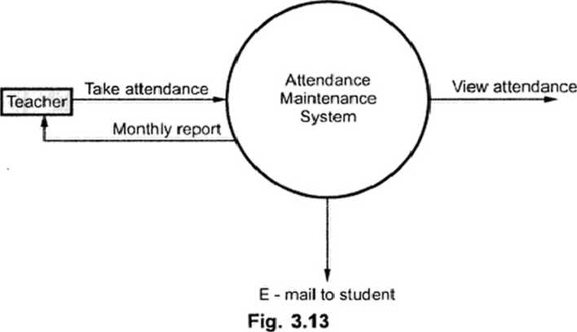
Conti…
2.1 User Manual
The system should provide Help option in which how to operate the system should be explained. Also hard copy of this document should be given to the user in a booklet form.

Slide 76
Conti…
3 Functional Requirements
3.1 Description
The identity of student is verified and then marked present at particular date and time. The system should display student photograph along with their names for that corresponding class. The student may be marked present or absent depending upon his presence. The system should send e-mails to absent students. A statistical report should display individual's report or a cumulative report whenever required.
3.2 Technical Issues
The system should be implemented in VC++.

Slide 77
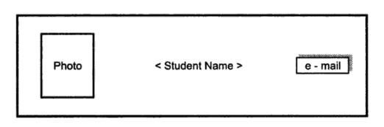
Conti…
4. Interface Requirements
4.1 GUI
GUI 1 : Main menu should provide options such as File, Edit, Report, Help.
GUI 2 : In File menu one can create a new record file or can open an existing record file. For example : If file SECOMP_SEMIj07 is opened then we may view attendance record of SE COMPUTER class in year 2007 and a record for semester-I can be viewed.
GUI 3 : The display of record should be (See Fig.)
The photo can be clicked to mark student present for particular class. The e-mail button can be clicked to send e-mail to the student being absent.
GUI 4 : Report option should display statistical report. It may be for particular student or for the whole class.

Slide 78
Conti…
GUI 5 : Help option should describe functionality of the system. It should be written in simple HTML.
4.2 Hardware Interface
Hardware Interface 1 : The system should be embedded in the laptops
Hardware Interface 2 : The laptop should use wireless Ethernet card to send
e-mails. These Laptops should be the clients of departmental database server.

Slide 79
Conti…
4.3 Software Interface
Software Interface 1 : Attendance maintenance system.
Software Interface 2 :The attendance database should be transmitted to departmental database server.
Software Interface 3 : E-mail message generator which generates standard message of absence.
Software Interface 4 : Report generators

Slide 80
Conti…
5 Performance Requirements
This system should work concurrently on multiple processors between the college hours. The system should support 50 users.
The e-mail should be sent within one hour after the class gets over.
The system should support taking attendance of maximum 100 students per class.
6 Design Constraints
The system should be designed within 6 months.
7 Other Non Functional Attributes
7.1 Security
The teacher should provide password to log on to the system. He/she should be able to see the record of his/her class.
The password can be changed by the Teacher by providing existing password.
7.2 Reliability
Due to wireless connectivity , reliability cannot be guaranteed.

Slide 81
Conti…
7.3 Availability
The system should be available during college hours.
7.4 Maintainability
There should be a facility to add or delete or update Teachers and students for each semester.
7.5 Reusability
The same system will be used in each new semester.
8 Operational Scenarios
There will be student database, Teacher database. The student database will contain students name, class, attendance, e-mail address, address, phone number.
The Teacher database will contain Teacher's name, classes taught, e-mail address, phone number.
9 Preliminary Schedule
The system has to be implemented within 6 months.

Slide 82
End

